Slide 1
OpenACC Course
Office Hour 4: Advanced OpenACC Techniques
Jiri Kraus, NVIDIA Developer Technologies

Slide 2
Oct 1: Introduction to OpenACC
Oct 6: Office Hours
Oct 15: Profiling and Parallelizing with the OpenACC Toolkit
Oct 20: Office Hours
Oct 29: Expressing Data Locality and Optimizations with OpenACC
Nov 3: Office Hours
Nov 12: Advanced OpenACC Techniques
Nov 24: Office Hours
Course Syllabus
Recordings: https://developer.nvidia.com/openacc-course

Slide 3
Answered Questions and Recordings https://developer.nvidia.com/openacc-course

Slide 4
Questions from the last class
Q1: Does the new PGI OpenACC for Multicore feature work with code like this?
Michael Wolfe’s blog post “OpenACC for Multicore CPUs” http://www.pgroup.com/lit/articles/insider/v6n3a1.htm
Q2: Can one achieve overlapping of two kernels?
Q3: When using device pointers with CUDA-aware MPI, are acceleration
technologies like GPUDirect P2P and RDMA automatically used?
Notes:
Answer to Q1: Yes but the async clause won‘t give overlapping of execution. This is no issue for the mandelbrot example as with the multicore target there will be no data transfers. But the technique to get overlap with MPI in the second part of the lecture won‘t work when compiling for multicore. You can find more information about the multicore support for OpenACC in Michael Wolfe’s blog post “OpenACC for Multicore CPUs” http://www.pgroup.com/lit/articles/insider/v6n3a1.htm

Slide 5
Can one achieve overlapping of two kernels?
35: for(int iter=0; iter<num_iters; ++iter) {
36: #pragma acc parallel loop num_gangs(120) async(0)
37: for (int i = 0; i < n; i++)
38: y[i] += x[i];
39: #pragma acc parallel loop num_gangs(120) async(1)
40: for (int i = 0; i < n; i++)
41: z[i] += w[i];
42: }
43: #pragma acc wait

Slide 6
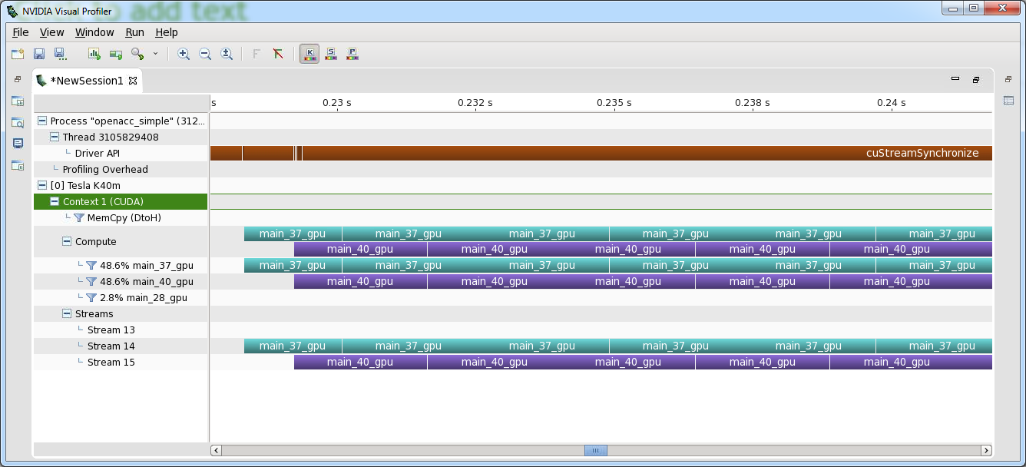
Can one achieve overlapping of two kernels?

Slide 7
CUDA-aware MPI and GPUDirect
Example
MPI Rank 0 MPI_Send from GPU Buffer
MPI Rank 1 MPI_Recv to GPU Buffer
Show how CUDA+MPI works in principle
Depending on the MPI implementation, message size, system setup, … situation might be different
Two GPUs in two nodes

Slide 8
CUDA-aware MPI and GPUDirect
Example
GPU Buffer
PCI-E DMA
Host Buffer
Pinned CUDA Buffer
Pinned fabric Buffer
memcpy
RDMA

Slide 9
CUDA-aware MPI and GPUDirect
GPUDirect RDMA
MPI Rank 0
MPI Rank 1
GPU
Host
#pragma acc host_data use_device(s_buf)
MPI_Send(s_buf,size,MPI_CHAR,1,tag,MPI_COMM_WORLD);
#pragma acc host_data use_device(s_buf)
MPI_Recv(r_buf,size,MPI_CHAR,0,tag,MPI_COMM_WORLD,&stat);

Slide 10
CUDA-aware MPI and GPUDirect
GPUDirect RDMA
MPI_Sendrecv
Time

Slide 11
Regular MPI and GPU Buffers
MPI Rank 0
MPI Rank 1
GPU
Host
cudaMemcpy(s_buf_h,s_buf_d,size,cudaMemcpyDeviceToHost);
MPI_Send(s_buf_h,size,MPI_CHAR,1,tag,MPI_COMM_WORLD);
MPI_Recv(r_buf_h,size,MPI_CHAR,0,tag,MPI_COMM_WORLD,&stat);
cudaMemcpy(r_buf_d,r_buf_h,size,cudaMemcpyHostToDevice);
cudaMemcpy(s_buf_h,s_buf_d,size,cudaMemcpyDeviceToHost);
MPI_Send(s_buf_h,size,MPI_CHAR,1,tag,MPI_COMM_WORLD);
MPI_Recv(r_buf_h,size,MPI_CHAR,0,tag,MPI_COMM_WORLD,&stat);
cudaMemcpy(r_buf_d,r_buf_h,size,cudaMemcpyHostToDevice);
cudaMemcpy(s_buf_h,s_buf_d,size,cudaMemcpyDeviceToHost);
MPI_Send(s_buf_h,size,MPI_CHAR,1,tag,MPI_COMM_WORLD);
MPI_Recv(r_buf_h,size,MPI_CHAR,0,tag,MPI_COMM_WORLD,&stat);
cudaMemcpy(r_buf_d,r_buf_h,size,cudaMemcpyHostToDevice);
cudaMemcpy(s_buf_h,s_buf_d,size,cudaMemcpyDeviceToHost);
MPI_Send(s_buf_h,size,MPI_CHAR,1,tag,MPI_COMM_WORLD);
MPI_Recv(r_buf_h,size,MPI_CHAR,0,tag,MPI_COMM_WORLD,&stat);
cudaMemcpy(r_buf_d,r_buf_h,size,cudaMemcpyHostToDevice);
#pragma acc update self(s_buf[0:size])
MPI_Send(s_buf,size,MPI_CHAR,1,tag,MPI_COMM_WORLD);
MPI_Recv(r_buf,size,MPI_CHAR,0,tag,MPI_COMM_WORLD,&stat);
#pragma acc update device(r_buf[0:size])

Slide 12
Regular MPI and GPU Buffers
memcpy D->H
MPI_Sendrecv
memcpy H->D
Time

Slide 13
CUDA-aware MPI
Without GPUDirect
MPI Rank 0
MPI Rank 1
GPU
Host
MPI_Send(s_buf_h,size,MPI_CHAR,1,tag,MPI_COMM_WORLD);
MPI_Recv(r_buf_h,size,MPI_CHAR,0,tag,MPI_COMM_WORLD,&stat);
MPI_Send(s_buf_h,size,MPI_CHAR,1,tag,MPI_COMM_WORLD);
MPI_Recv(r_buf_h,size,MPI_CHAR,0,tag,MPI_COMM_WORLD,&stat);
#pragma acc host_data use_device(s_buf)
MPI_Send(s_buf,size,MPI_CHAR,1,tag,MPI_COMM_WORLD);
#pragma acc host_data use_device(s_buf)
MPI_Recv(r_buf,size,MPI_CHAR,0,tag,MPI_COMM_WORLD,&stat);

Slide 14
CUDA-aware MPI
Without GPUDirect
MPI_Sendrecv
Time

Slide 15
CUDA-aware MPI and GPUDirect
Latency (1 byte) | 19.79 us | 17.97 us | 5.70 us

Slide 16
Where to find help
OpenACC Course Recordings and Q&A - https://developer.nvidia.com/openacc-course
OpenACC on StackOverflow - http://stackoverflow.com/questions/tagged/openacc
OpenACC Toolkit - http://developer.nvidia.com/openacc
Additional Resources:
Parallel Forall Blog - http://devblogs.nvidia.com/parallelforall/
GPU Technology Conference - http://www.gputechconf.com/
OpenACC Website - http://openacc.org/

